Slide 1


Introduction to Operating Systems CS 1550
Spring 2023
Sherif Khattab
ksm73@pitt.edu
(Some slides are from Silberschatz, Galvin and Gagne ©2013)

Slide 2
Announcements
Upcoming deadlines:
Homework 11: due on 4/18
Project 3: Late due date on 4/13
Late penalty waived
Lab 4: due on 4/15
Quiz 3: due on 4/15
Homework 12: due on 4/25
Lab 5: due on 5/2
Project 4 and Quiz 4: due on 5/2
Bonus Homework: due on 5/2
Course Post-Test: due on 5/2

Slide 3
Muddiest Points (1/2)
when is the parity checked to see if there is a bit error
a little confused about parity example
How to flip the correct bits back that were changed with parity?
What is parity used for
ECC
What things move how using what in the disk
disk request time delay factors
transfer time/rotating time/seek time
I feel like rotational delay and actual transfer time are overlapped. The sector is spending time to rotate to the head, and at the same time, the head is rotating to find that sector. Are they moving towards each other at the same time?

Slide 4
Disk drive structure
head
sector
platter
track
cylinder
surfaces
spindle
actuator

Slide 5
Muddiest Points (2/2)
In the last top hat question, why the page table gets smaller if the page frames are larger. I understand that would mean less entries, but wouldn't each entry would be larger, making the overall table the same size?
What are RAIDs for?
Does RAID4 have any advantages over RAID5?
All of it, bro

Slide 6
Problem of the Day – Part 1
How does a file system handle errors?
Answer: Defense in Depth
multiple layers of error detection/correction

Slide 7
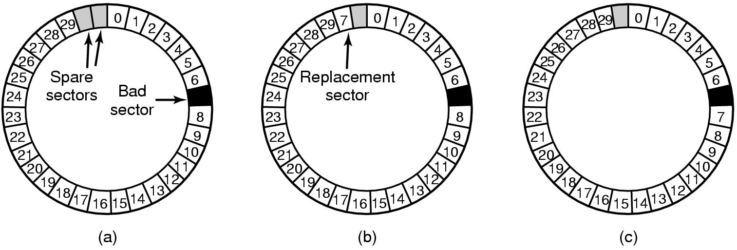
When good disks go bad…
Disks have defects
In 3M+ sectors, this isn’t surprising!
ECC helps with errors, but sometimes this isn’t enough
Disks keep spare sectors (normally unused) and remap bad sectors into these spares
If there’s time, the whole track could be reordered…

Slide 8
RAIDs, RAIDs, and more RAIDs
Stripe
strip
strip
RAID 0
(Redundant Array of Inexpensive Disks
RAID 1
(Mirrored copies)
RAID 4
(Striped with parity)
RAID 5
(Parity rotates through disks)

Slide 9
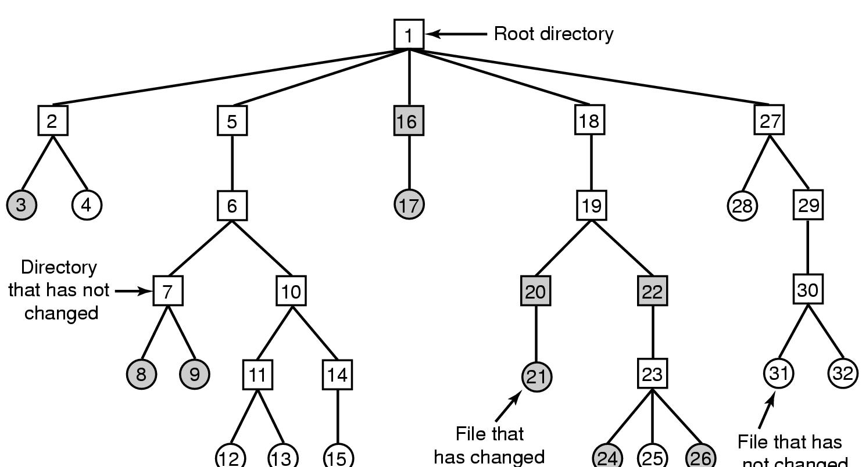
Backing up a file system
A file system to be dumped
Squares are directories, circles are files
Shaded items, modified since last dump
Each directory & file labeled by i-node number
File that has
not changed

Slide 10
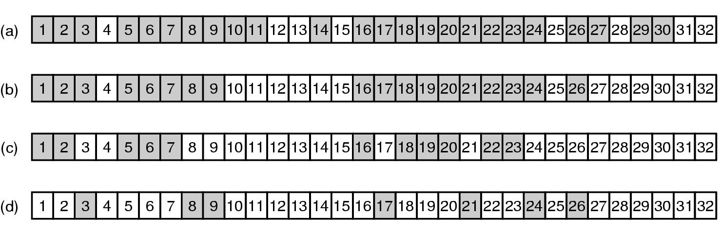
Bitmaps used in a file system dump

Slide 11
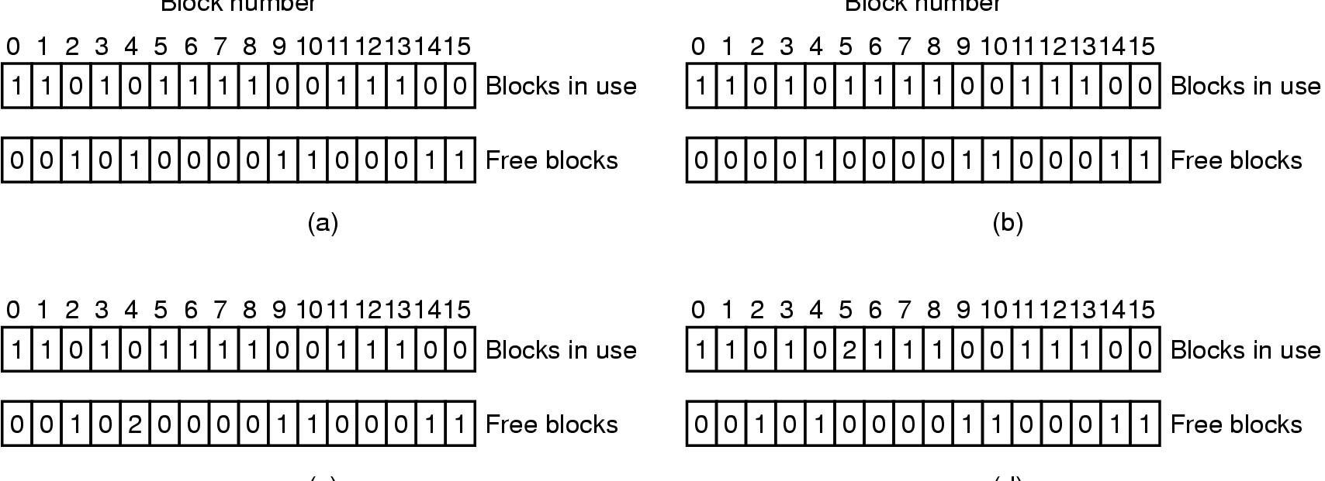
Checking the file system for consistency
Consistent
Missing (“lost”) block
Duplicate block in free list
Duplicate block in two files

Slide 12
Problem of the Day – Part 2
How does a file system hide disk access delays?
Answer: Caching

Slide 13
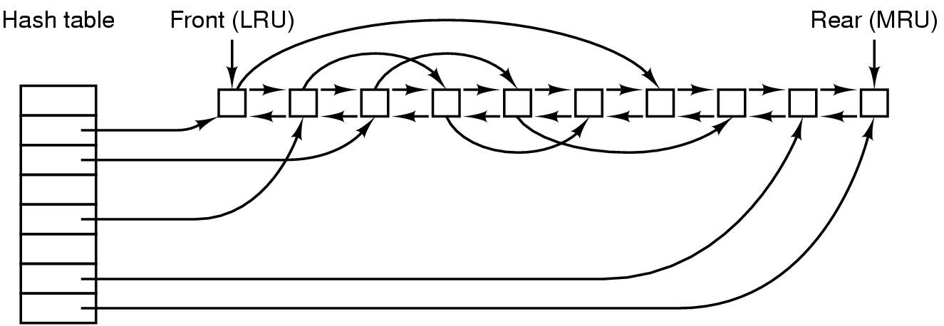
File block cache data structures

Slide 14
Log-structured file systems
Trends in disk & memory
Faster CPUs
Larger memories
Result
More memory -> disk caches can also be larger
Increasing number of read requests can come from cache
Thus, most disk accesses will be writes
LFS structures entire disk as a log
All writes initially buffered in memory
Periodically write these to the end of the disk log
When file opened, locate i-node, then find blocks
Issue: what happens when blocks are deleted?

Slide 15
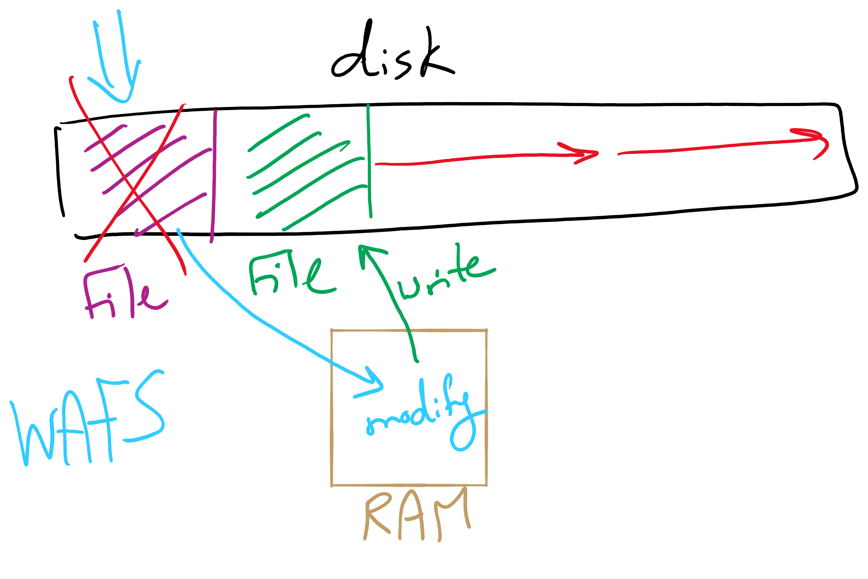
Log Structured File System

Slide 16
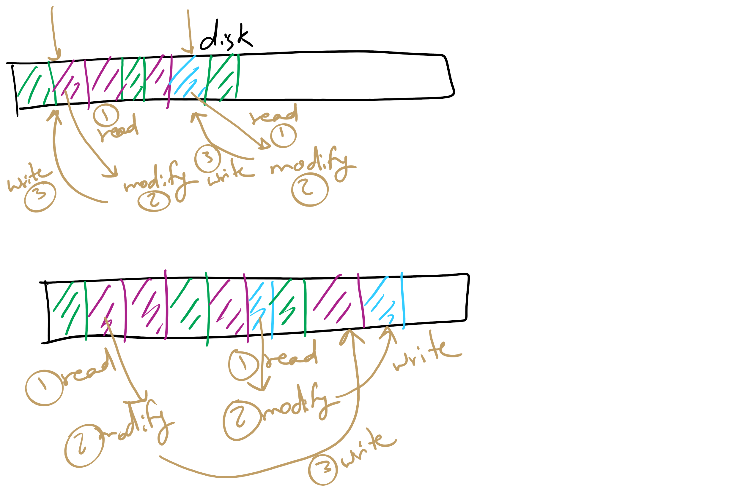
Log Structured File System

Slide 17
Flash File System
Wear Leveling
Count total writes per flash sector and attempt to balance across the whole disk

Slide 18
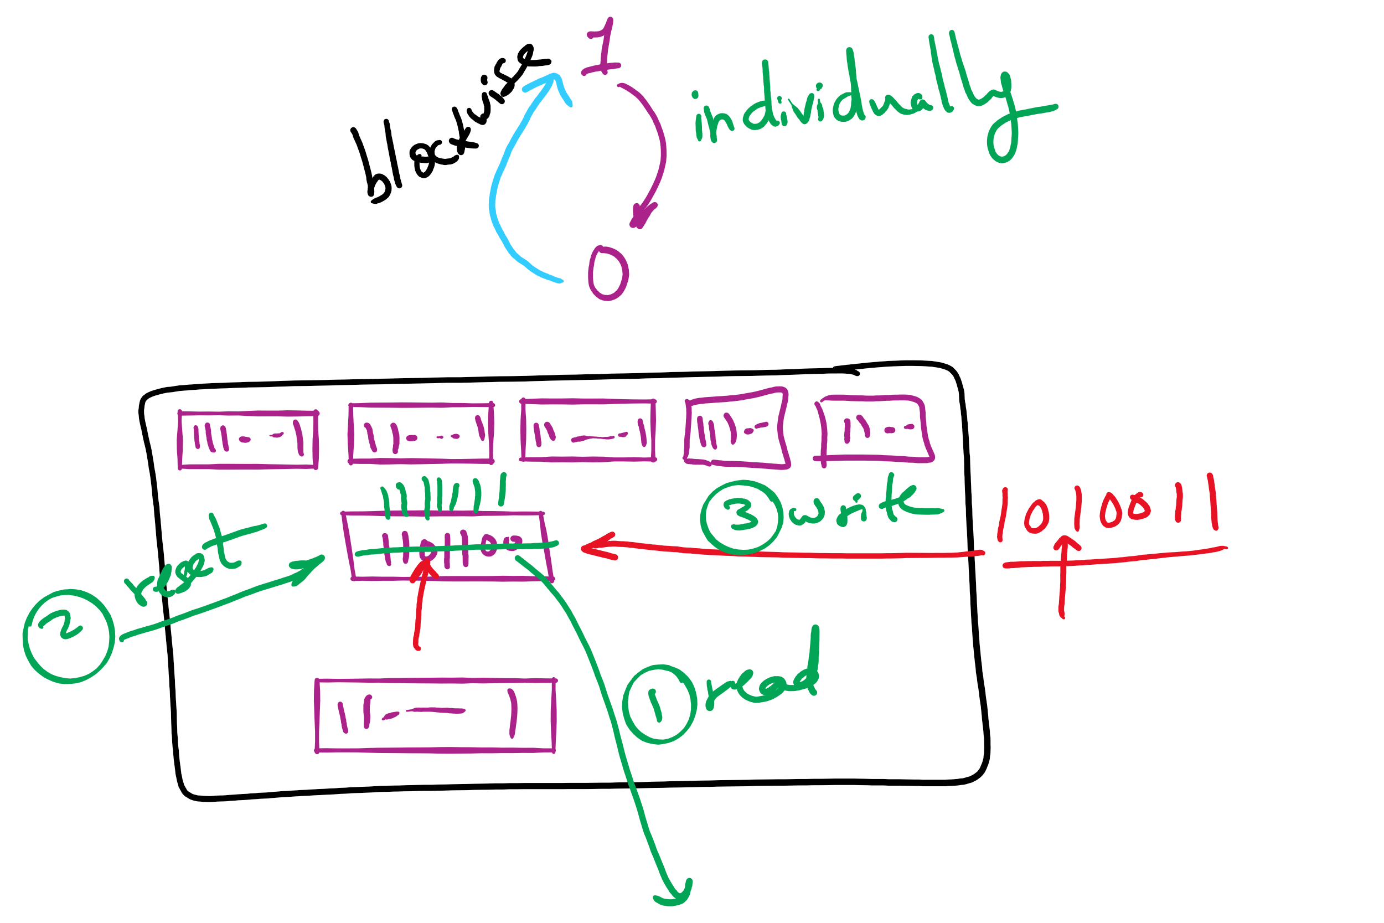
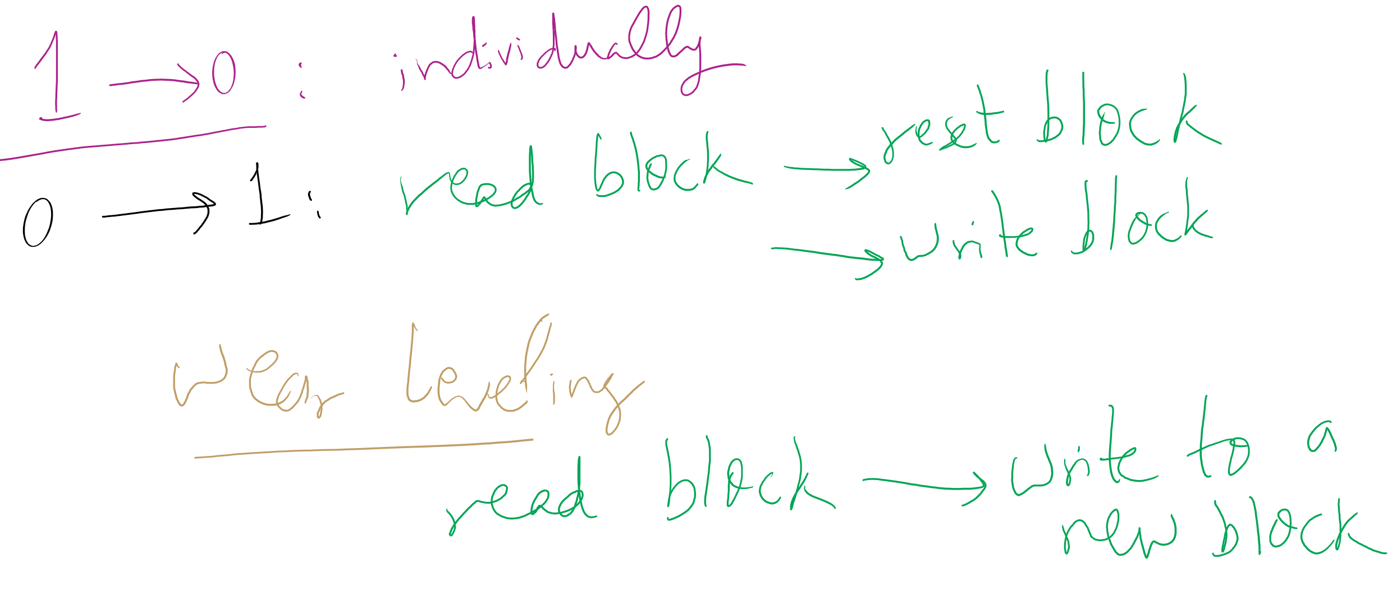
Wear leveling for SSDs

Slide 19
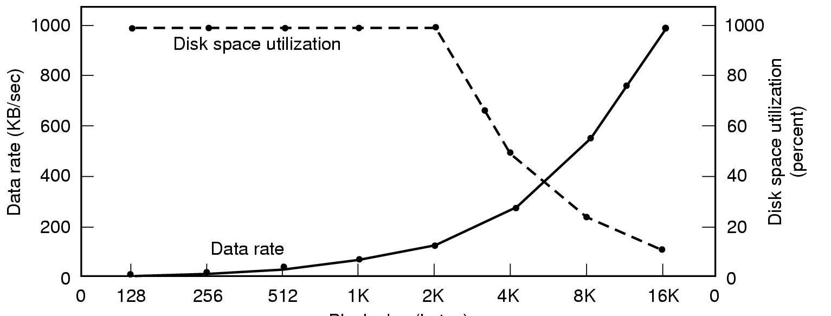
Disk block size
Dark line (left hand scale) gives data rate of a disk
Dotted line (right hand scale) gives disk space efficiency
All files 2KB
Block size

Slide 20
Problem of the Day – Part 3
How do device drivers program I/O devices?
Answer: three methods
polling
Interrupts
DMA

Slide 21
How are I/O devices connected?
Single-bus
All memory accesses go over a shared bus
I/O and RAM accesses compete for bandwidth
Dual-bus
RAM access over high-speed bus
I/O access over lower-speed bus
Less competition
More hardware (more expensive…)
CPU
Memory
I/O
CPU
Memory
I/O
This port allows I/O devices access into memory

Slide 22
Memory-Mapped vs. separate I/O Space
Memory
0xFFF…
I/O ports
0
Separate I/O & memory space
Memory-mapped I/O
Hybrid: both memory-mapped & separate spaces

Slide 23
Example: Dynamic Frequency on XScale

Slide 24
Programmed I/O example: printing a page
User
Printed page
Printed page
Printed page
ABCD EFGH
ABCD EFGH
ABCD EFGH
A
AB
Kernel
ABCD EFGH
ABCD EFGH

Slide 25
Polling
copy_from_user (buffer, p, count); // copy into kernel buffer
for (j = 0; j < count; j++) { // loop for each char
while (*printer_status_reg != READY)
; // wait for printer to be ready
*printer_data_reg = p[j]; // output a single character
}
return_to_user();

Slide 26
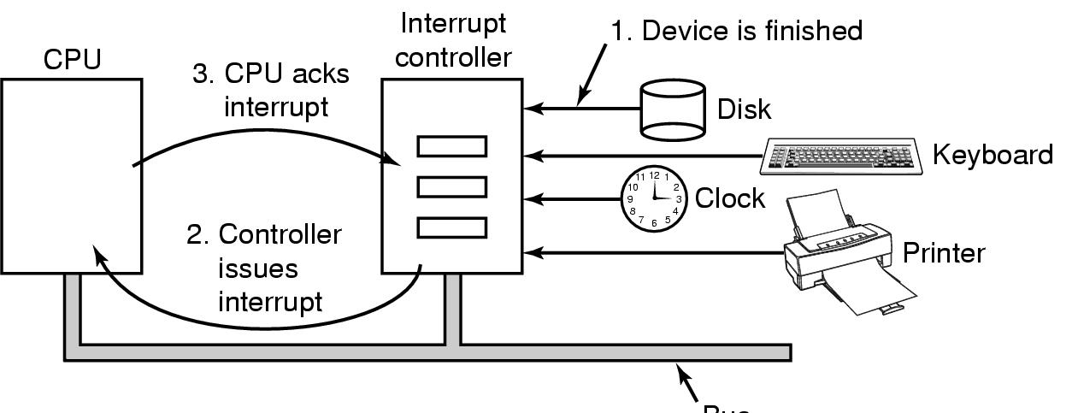
Hardware’s view of interrupts
Bus

Slide 27
Interrupt-driven I/O
copy_from_user (buffer, p, count);
j = 0;
enable_interrupts();
while (*printer_status_reg != READY)
;
*printer_data_reg = p[0];
scheduler(); // and block user
Code run by system call
if (count == 0) {
unblock_user();
} else {
j++;
*printer_data_reg = p[j];
count--;
}
acknowledge_interrupt();
return_from_interrupt();
Code run at interrupt time
(Interrupt handler)

